Slide 1






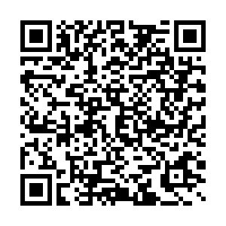

section 1
Planning for
9th Grade and Beyond
at RFH
section 2
section 3
section 4
Scan here
section 5

Slide 2



Upcoming Class of 2028 Events
Tonight's
Goals...
section 1
Course Scheduling Activities - January through June
  Meetings with 8th graders
  Teacher Recommendations
  Formal Course Selection Meetings
  WL Placement Test & Waiver Windows
  Schedule Release
section 2
Freshman Orientation & Parent Night - August
  Technology intro and Chromebook distribution
  Meet and greet with administrators and counselors
  Discussion of high school expectations
Registration Reminders
The Transition to High School
Mapping out 9th Grade-Course Selection & Program of Studies
The 4 Year Vision
section 3
section 4
High School Begins - September
  Officially become a Bulldog!
section 5

Slide 3


Middle School
High School
  Needed structure and oversight
  Grade-specific content and student groups
  Predominantly required curricula and introduction to new material
  School-based extracurriculars
  Various forms/genres/types of reading, writing, and analysis in English and Social Studies
  Problem-solving, collaboration, and inquiry in Math and Science
  More individual freedom AND individual responsibility
  Interactions with students across grade levels in elective courses and through EXPANDED extracurriculars
  More academic and elective course offerings and chances for exploration
  Increased volume of reading and writing and more sophisticated analysis and engagement of texts and events in English and Social Studies
  In-depth explanations of processes and immersive, hands-on, and real-world, practical experiences and connections in Math, Science, World Languages, and elective areas
section 2
section 3
section 4
section 5

Slide 4

Change is stressful. Allow time to acclimate.
Nothing is static. Flexibility in level changes promotes proper fit and potential growth.
Exploration is encouraged! Academic and extracurricular opportunities abound and now is the time!
High school counts...and we'll counsel and support your student the whole way.
Balance is key...
and we're here
to support!
section 2
section 3
section 4
section 5

Slide 5


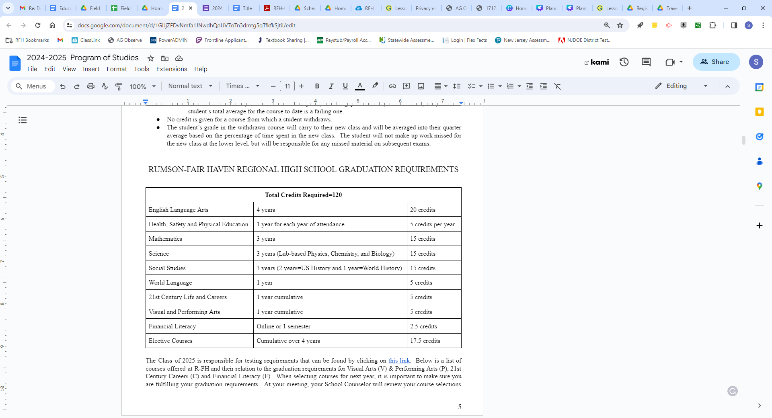
Graduation Requirements
section 3
section 4
section 5

Slide 6
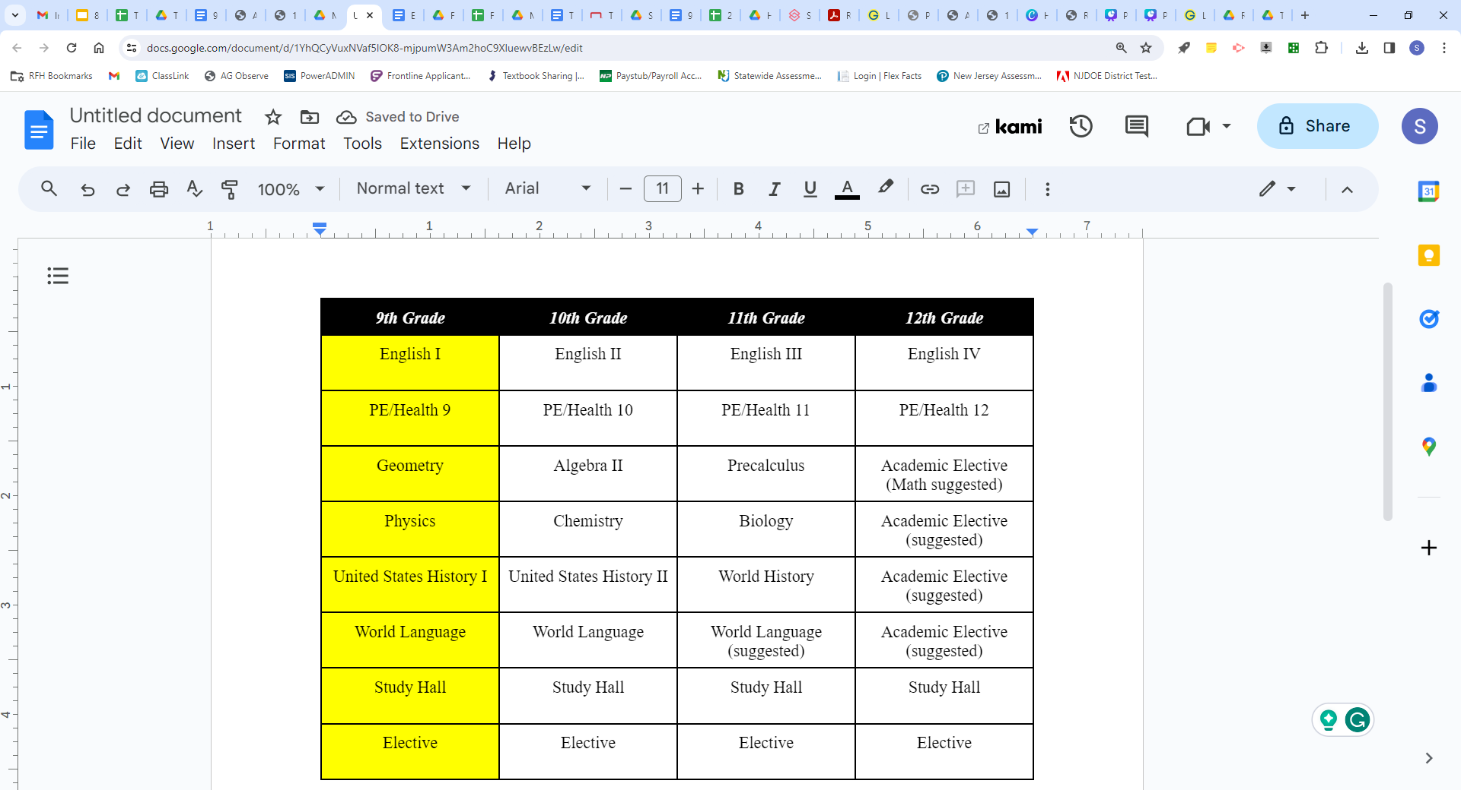




Sample 4-Year Worksheet
section 3
section 4
section 5

Slide 7

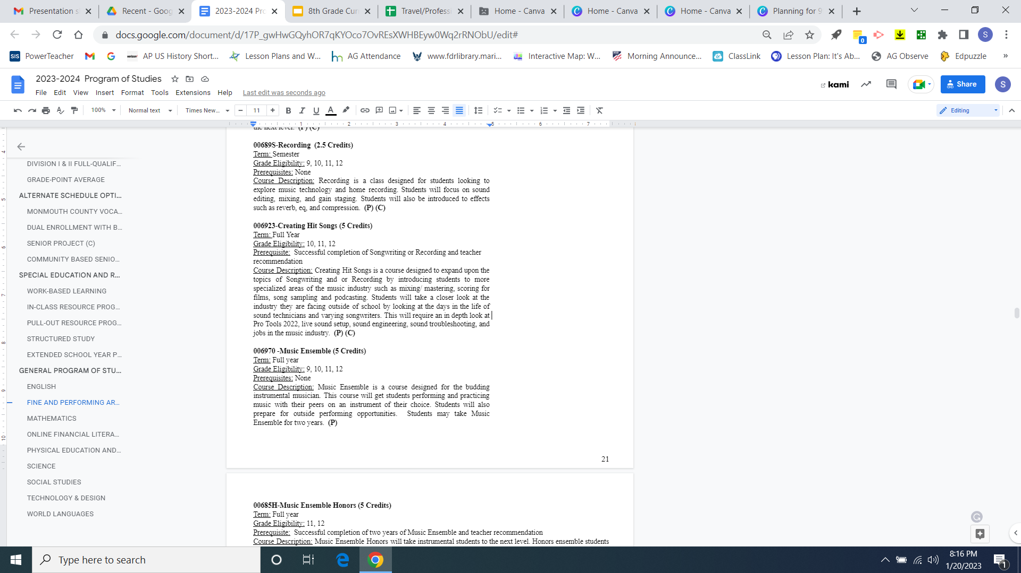

Review of the Program of Studies
Course Levels
Take note of the following:
Course Duration
Grade Level
Prerequisites
College Prep/General
  Differentiated instruction and assessment
  Pacing to accommodate group dynamic
  Analyze information, synthesize ideas, application of ideas
section 3
Honors/Advanced Placement/Dual Enrollment
  Pacing related to end-of-course goals and/or assessment
  Greater and deeper expectations of skills in analyzing, synthesizing, and applying knowledge
  Greater workload and independent management of tasks and expectations
section 4
section 5

Slide 8


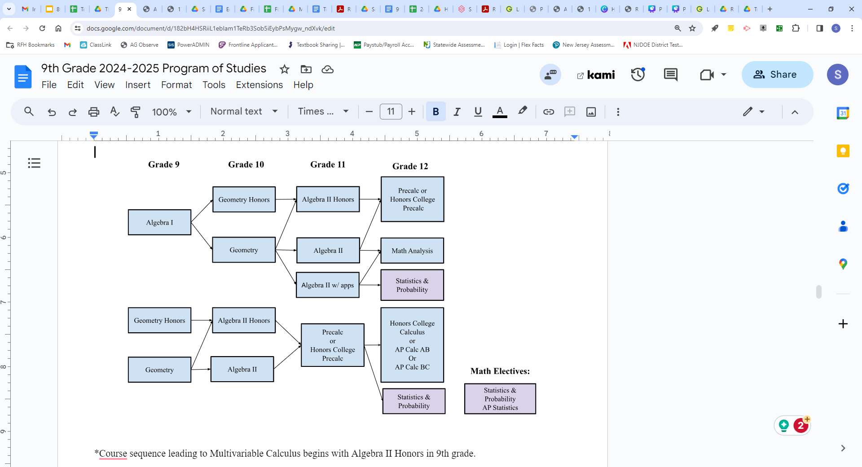

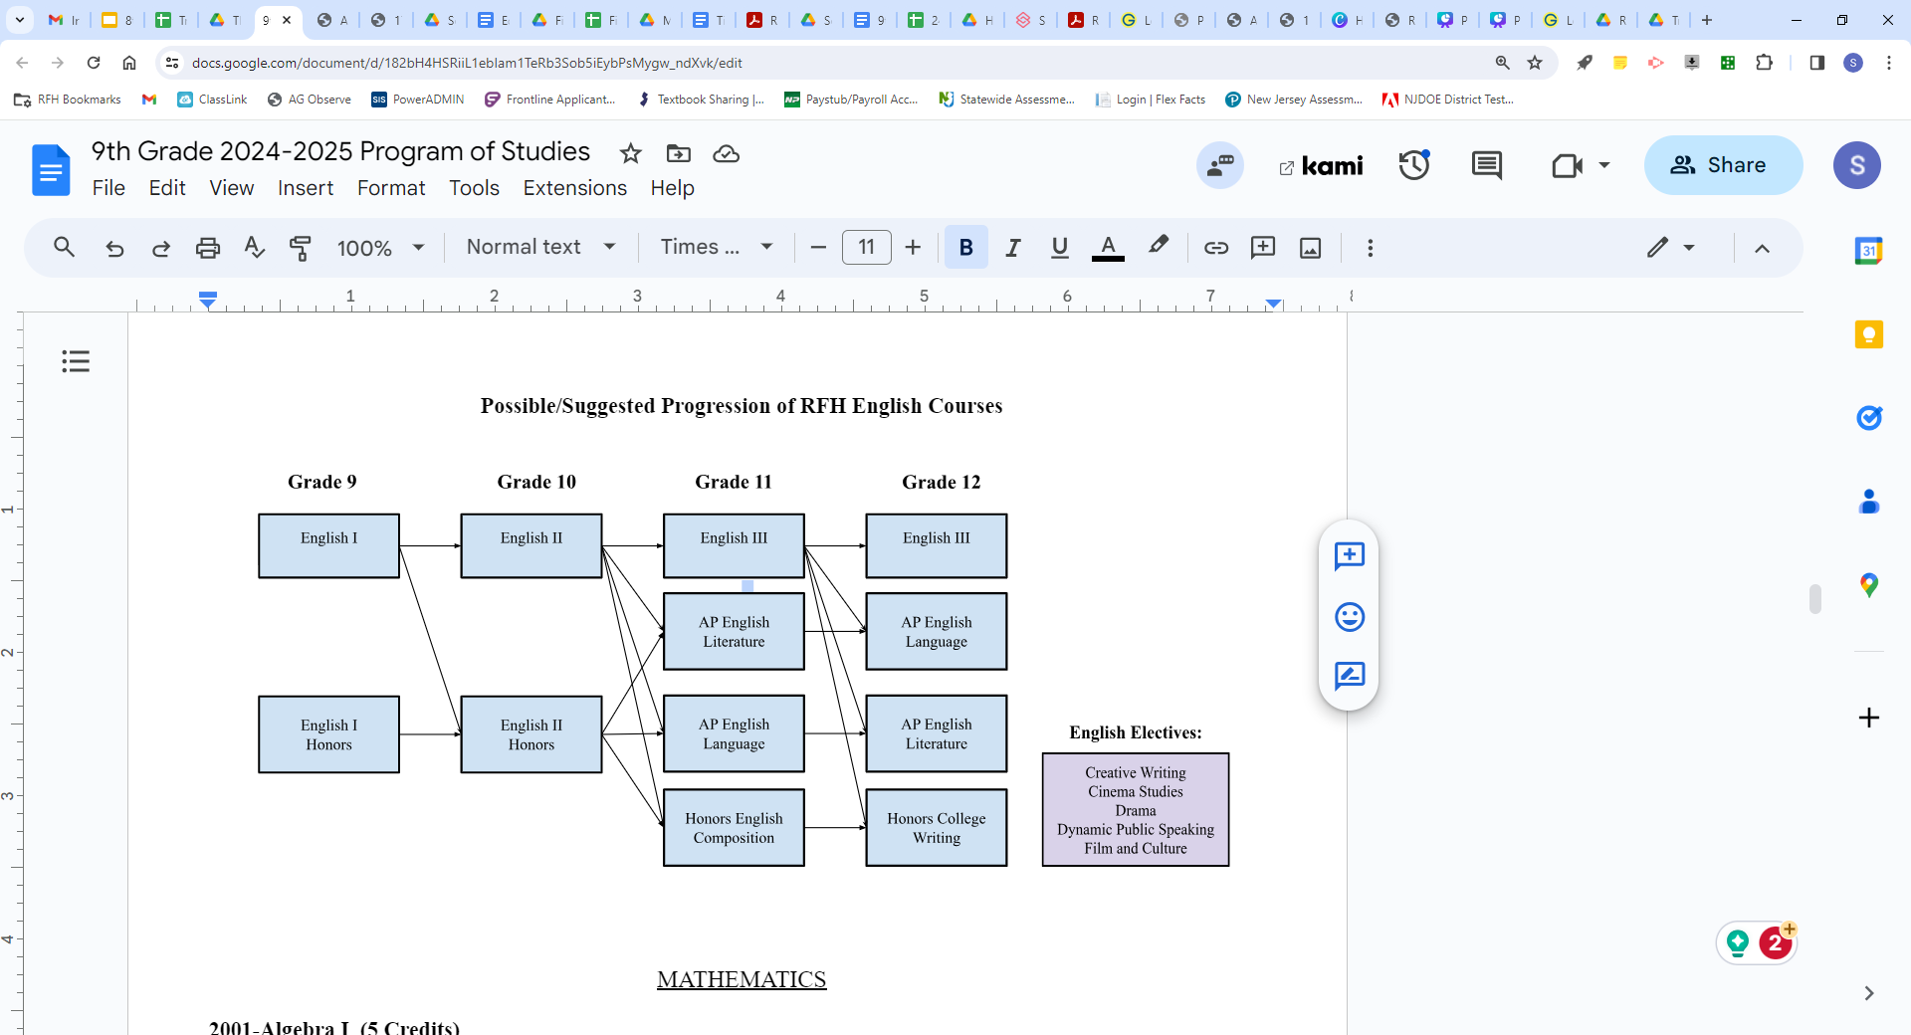


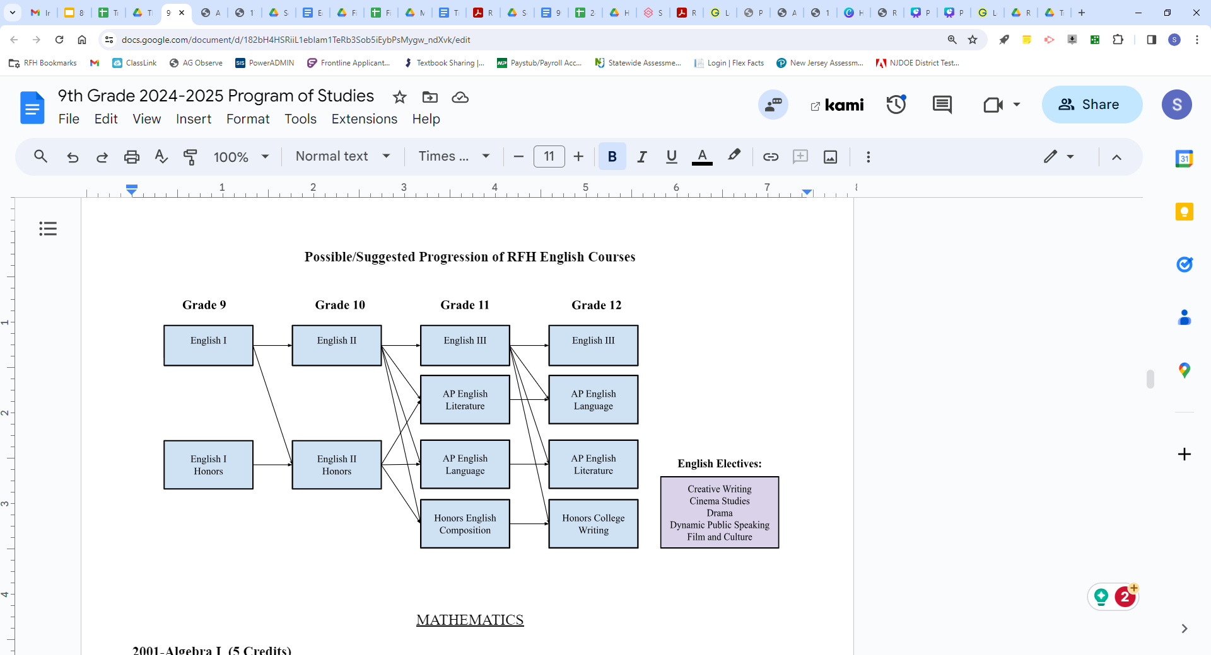
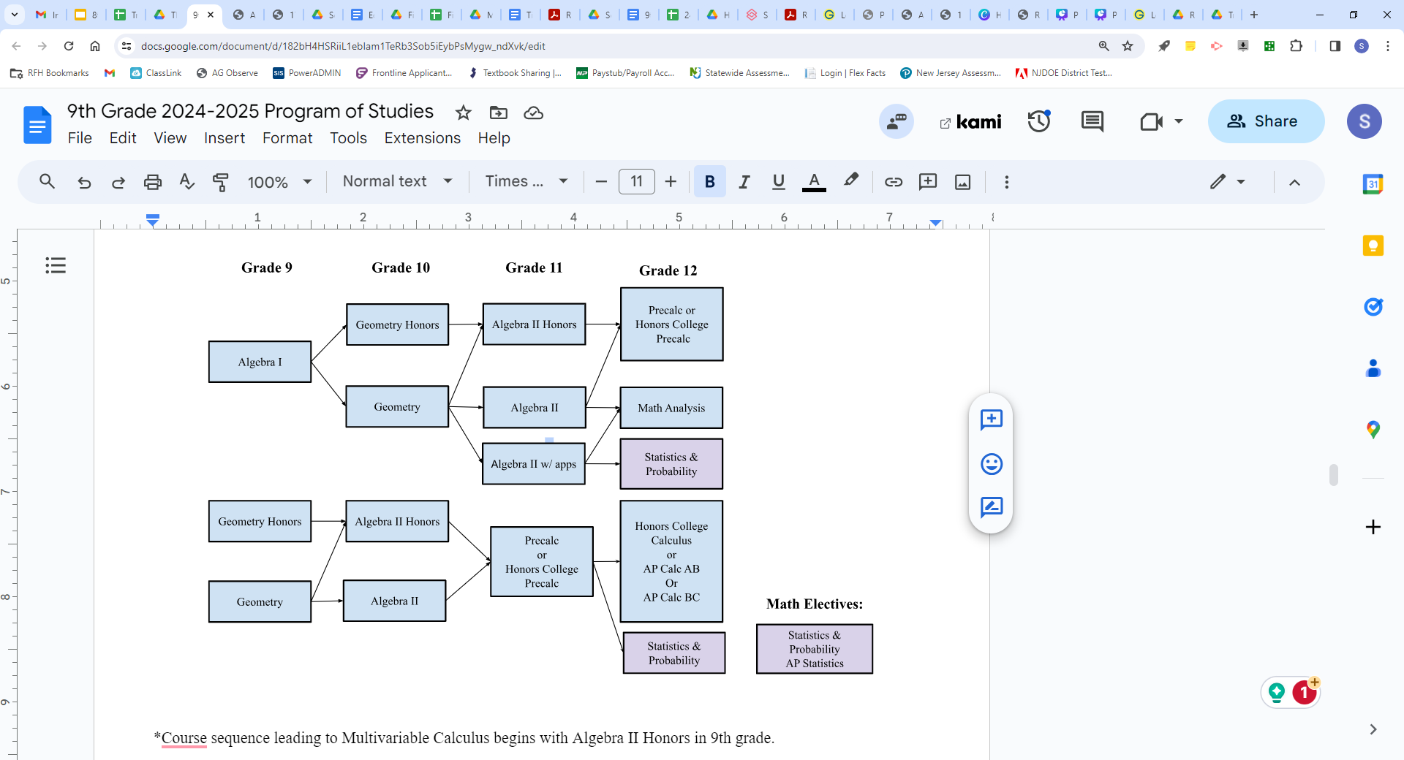
Possible course progressions...
Mathematics
Add notes here
English
section 4
section 5

Slide 9

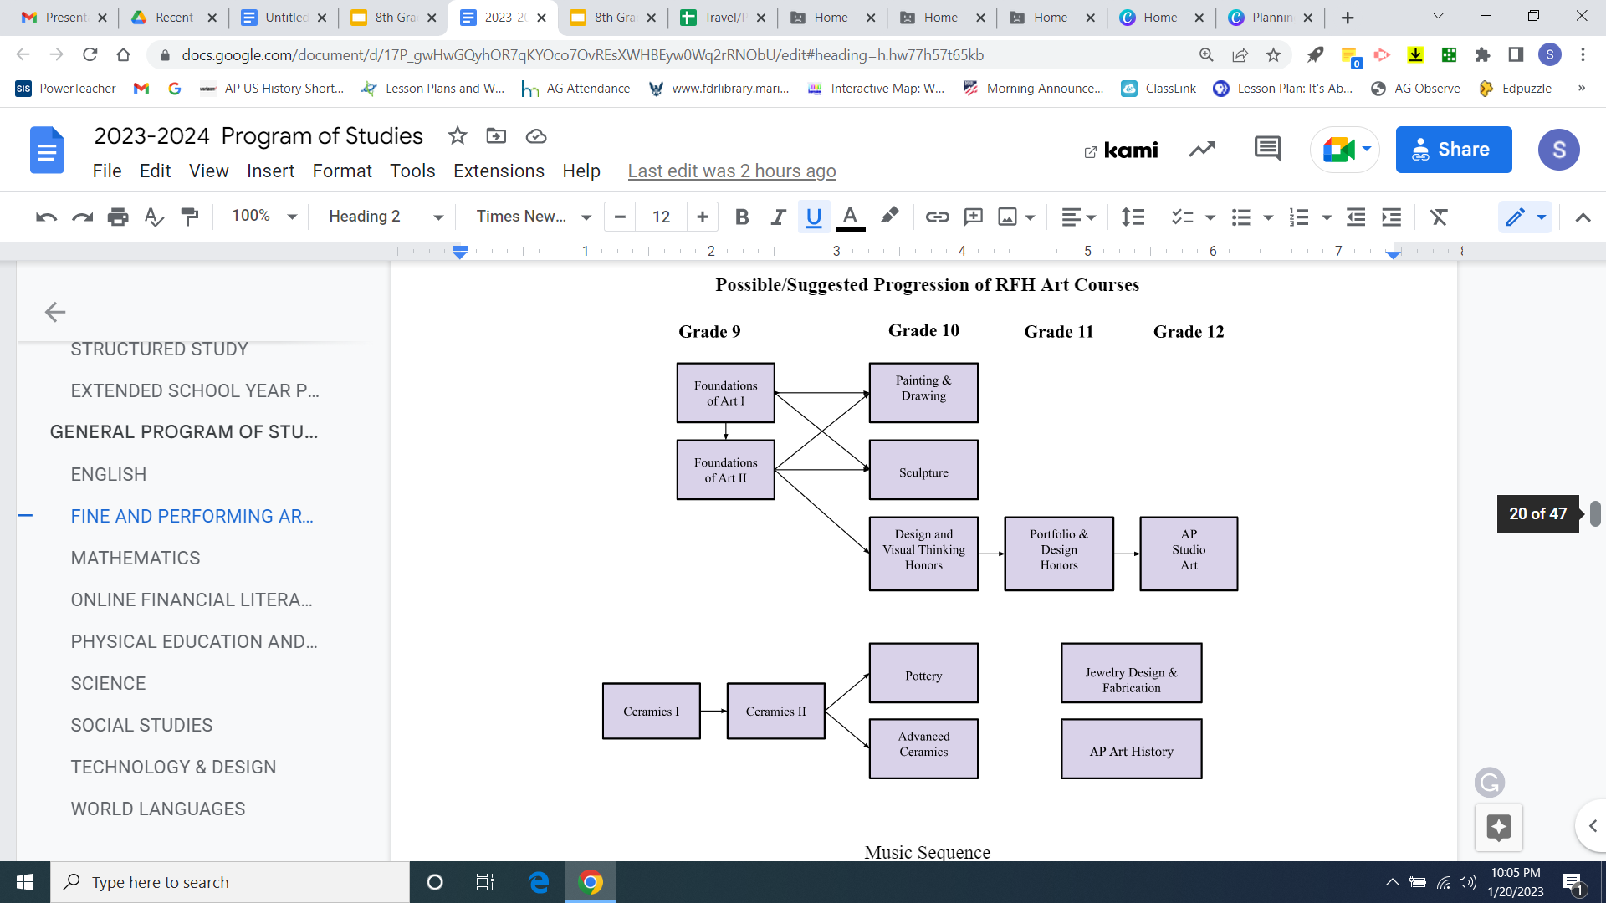

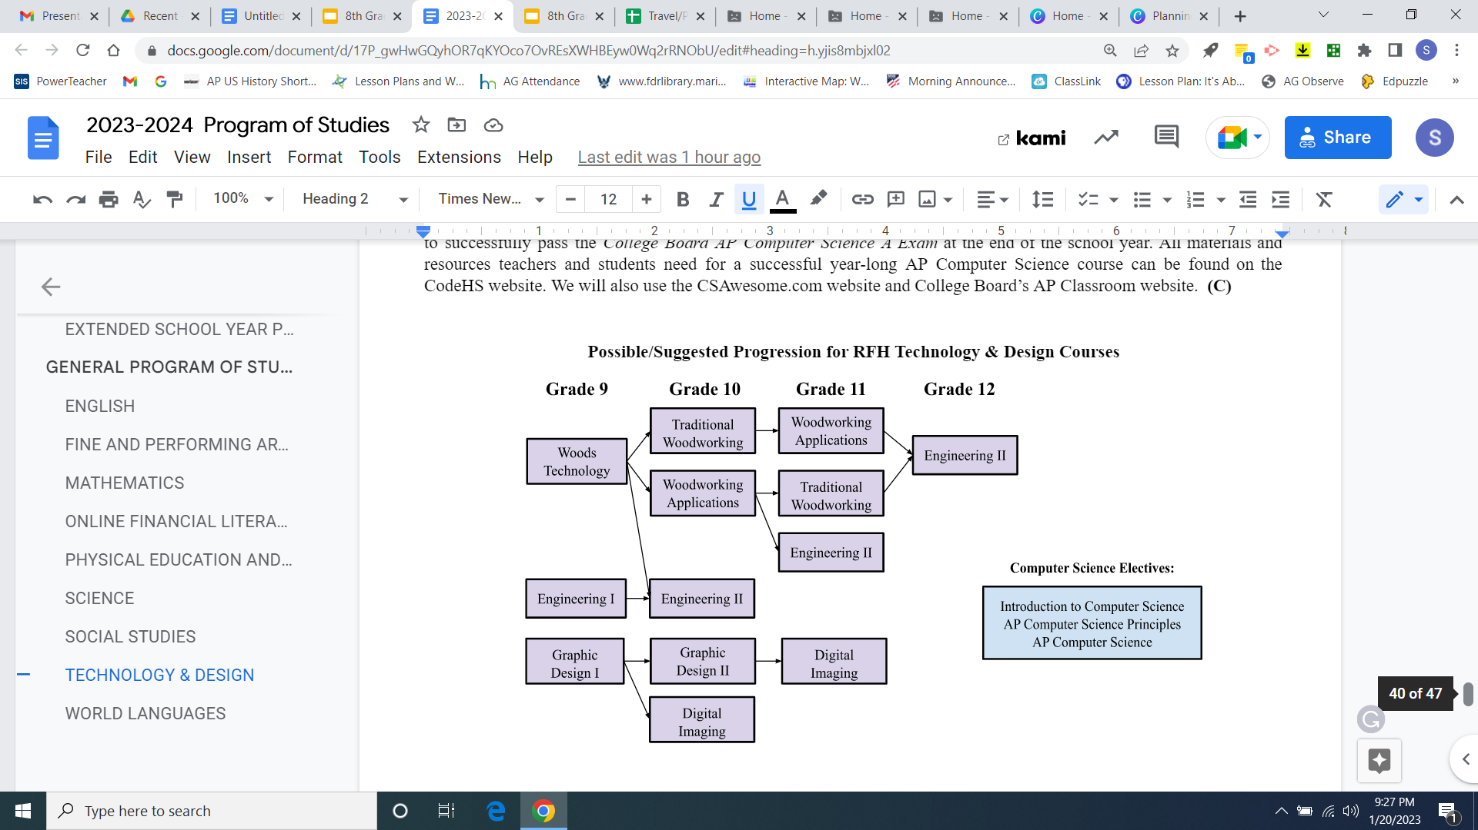

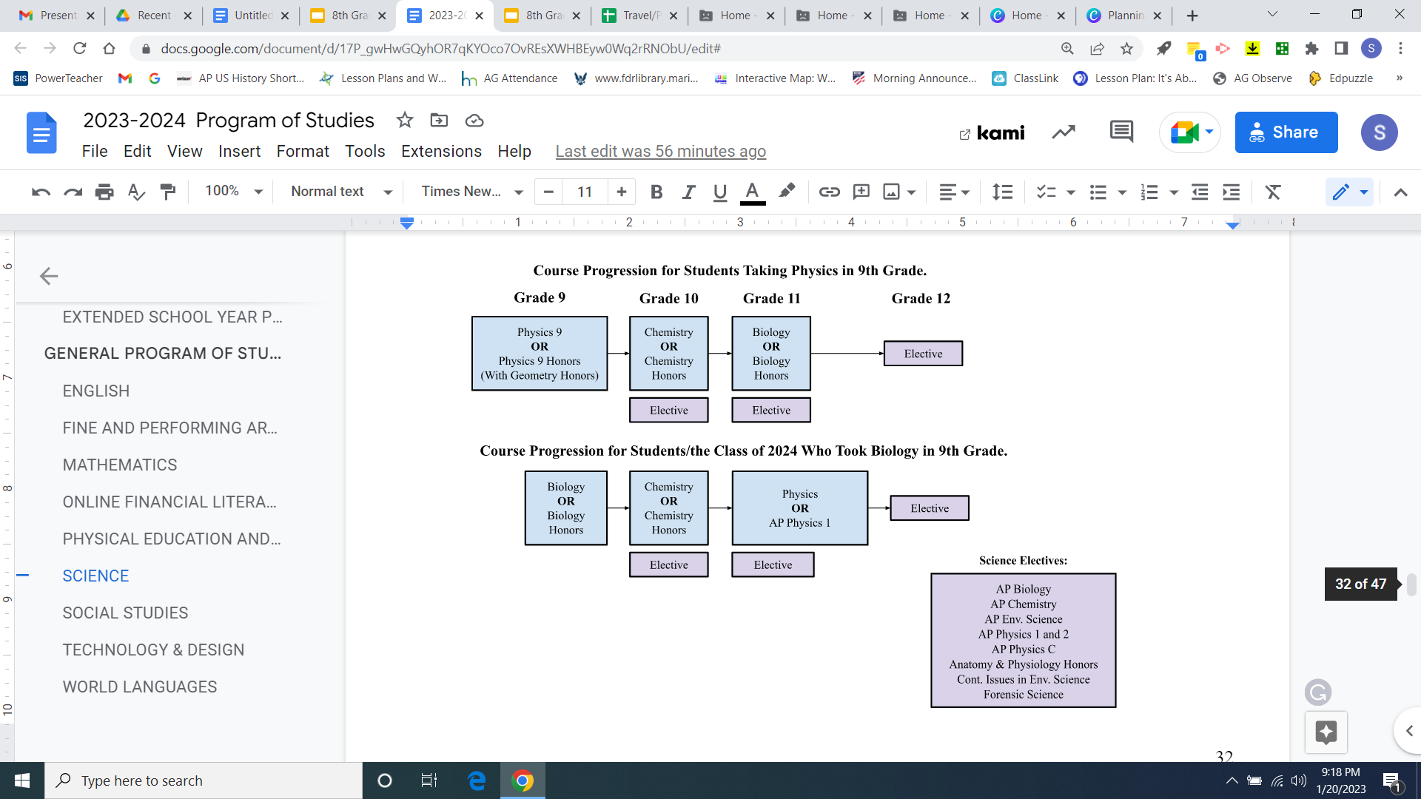

Art
Don't forget to look ahead!
Technology & Design
section 4
Science
section 5

Slide 10

Things to Know...
Scheduling timeline
Course Recommendations
  Current 8th grade teacher will make recommendations in core subjects
  Teacher recommendation is based on their knowledge of the high school curricula and student achievement
3/1: Registration Deadline
3/4-3/12: Counselors meet with 8th graders and parents for course selection.
3/19: Deadline to request waiver meeting through Google Form.
3/18-3/22: Waiver Window
3/21: WL Placement Test
Waiver & WL Placement Test Process
  Speak with RFH counselor & complete Google Form to request Waiver Meeting/WL Placement Test
  Discuss with RFH Department Supervisors
  Submit signed waiver form to RFH School Counseling Office
  Must remain in course until the end of Q1 and grade transfers
Scheduling Constraints
  Singletons
  Course Alternatives
section 5

Slide 11

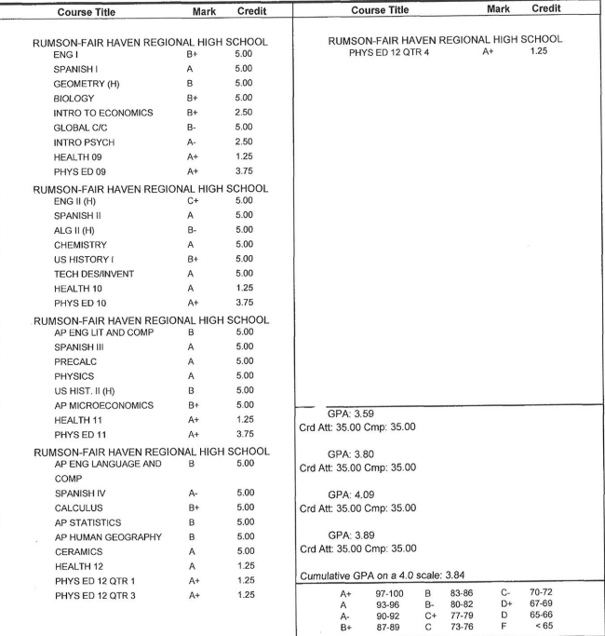
Student with a 3.84 GPA
Applied and Admitted
  University of Maryland (20%)
  University of Connecticut (23%)
  Ohio State University (53%)
  University of Vermont (64%)
  Duquesne University (77%)
  Indiana University (85%)
  Quinnipiac University (82%*)
Denied or Waitlisted
  Northeastern University (18%*)
section 5
% reflects out of state admission rate, *Private School

Slide 12
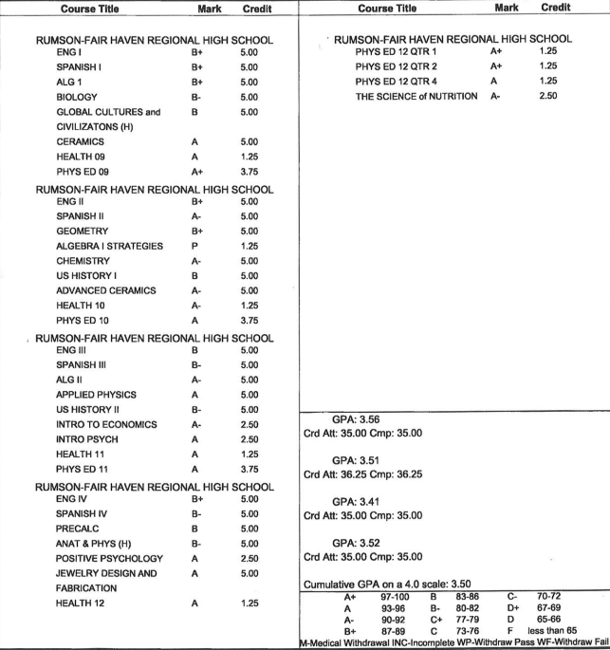
Student with a 3.50 GPA
Applied and Admitted
  Clemson University (49%)
  Syracuse University (59%)
  University of Alabama (61%)
Denied and Waitlisted
  Florida State University (37%)
  University of Auburn (44%)
  Texas Christian University-waitlisted (48%*)
section 5
% reflects out of state admission rate, *Private School

Slide 13

The Journey
Each experience is truly unique.
TOGETHER, we'll work to prepare our students for their next step, whatever that may be.
We are doing more than just academic preparation, we're teaching life skills.
Students will stumble; no one is perfect. But we'll be there to pick them up!

Slide 14



Thank you for coming!
We can't wait
to welcome the
Class of 2028!
GO dawgs

